Slide 1
Azure Cosmos DB
<Speaker>
<date>

Slide 2
Modern apps face new challenges
Managing and syncing data distributed around the globe
Delivering highly-responsive, real-time personalization
Processing and analyzing large, complex data
Scaling both throughput and storage based on global demand
Offering low-latency to global users
Modernizing existing apps and data

Slide 3



Azure Cosmos DB
A globally distributed, massively scalable, multi-model database service
SQL
MongoDB
Table API
Column-family
Document
Key-value
Graph
Guaranteed low latency at the 99th percentile
Elastic scale out
of storage & throughput
Five well-defined consistency models
Turnkey global distribution
Comprehensive SLAs

Slide 4
Azure Cosmos DB
A FULLY-MANAGED GLOBALLY DISTRIBUTED DATABASE SERVICE BUILT TO GUARANTEE
EXTREMELY LOW LATENCY AND MASSIVE SCALE FOR MODERN APPS

Slide 5
Top 10 reasons why customers use Azure Cosmos DB
The 1st and only database with global distribution turnkey capability
Deliver massive storage/throughput scalability database
Provides guaranteed single digit millisecond latency at 99th percentile worldwide
Natively supports different types of data at massive scale
Boasts 5 well-defined consistency models to pick the right consistency/latency/ throughput tradeoff
Enables mission critical intelligent applications
Gives high flexibility to optimize for speed and cost
Tackles big data workloads with high availability and reliability
Provides multi-tenancy and enterprise-grade security
Naturally analytics-ready and perfect for event-driven architectures

Slide 6
Powering global solutions
Azure Cosmos DB was built to support modern app patterns and use cases.
It enables industry-leading organizations to unlock the value of data, and respond to global customers and changing business dynamics in real-time.
Data distributed and available globally
Build real-time customer experiences
Ideal for gaming, IoT & eCommerce
Simplified development with serverless architecture
Run Spark analytics over operational data
Migrate NoSQL data and Apps
Puts data where your users are
Enable latency-sensitive personalization, bidding, and fraud detection.
Predictable and fast service, even during traffic spikes
Fully-managed event-driven micro-services with elastic computing power
Accelerate insights from fast, global data with Azure Cosmos DB and Azure Data Bricks
Migrate MongoDB and Cassandra and other NoSQL workloads

Slide 7


Data distributed and available globally
Put your data where your users are to give real-time access and uninterrupted service to customers anywhere in the world.
Turnkey global data replication across all Azure regions
Guaranteed low-latency experience for global users
Resiliency for high availability and disaster recovery
Azure region A
<10 ms
Azure Cosmos DB (app + session state)
Browser
Azure Traffic Manager
Azure region B
<10 ms
Globally distributed across regions
Azure region C
<10 ms

Slide 8



Build Real-Time Customer experiences
Online Recommendations Service HOT path
Offer latency-sensitive applications with personalization, bidding, and fraud-detection.
Machine learning models generate real-time recommendations across product catalogues
Product analysis in milliseconds
Low-latency ensures high app performance worldwide
Tunable consistency models for rapid insight
Azure Service Fabric
(Personalization Decision Engine)
Azure Cosmos DB
(distributed model store)
Azure Data Factory
(scheduled job to refresh persisted models)
Shoppers
.com
(Product Details Page)
Azure Event Hub
Azure Data Lake Storage
(offline raw data)
Apache Spark on Azure Databricks
Offline Recommendations Engine COLD path

Slide 9


Ideal for gaming, IoT and ecommerce
Maintain service quality during high-traffic periods requiring massive scale and performance.
Instant, elastic scaling handles traffic bursts
Uninterrupted global user experience
Low-latency data access and processing for large and changing user bases
High availability across multiple data centers
Azure CDN
Azure Storage (Game files)
Azure API Apps (Game backend)
Azure Cosmos DB (Game database)
Azure Databricks (Game analytics)
Azure Functions
Azure Notification Hub (Push notifications)

Slide 10





Massive Scale Telemetry Stores for IOT
Diverse and unpredictable IoT sensor workloads require a responsive data platform
Seamless handling of any data output or volume
Data made available immediately, and indexed automatically
High writes per second, with stable ingestion and query performance
Azure IoT Hub
Apache Storm on Azure HDInsight
Azure Cosmos DB
(Telemetry & device state)
Azure Web Jobs (Change feed processor)
Azure Storage (archival)
Logic apps

Slide 11
simplified development with serverless architecture
Azure Functions
(E-commerce Checkout, API)
Azure Cosmos DB
(Order event score)
Experience decreased time-to-market, enhanced scalability, and freedom from framework management with event-driven micro-services.
Seamless handling of any data output or volume
Data made available immediately, and indexed automatically
High writes per second, with stable ingestion and query performance
Real-time, resilient change feeds logged forever and always accessible
Native integration with Azure Functions
Change feed
Azure Functions
(Microsoft 1: Tax)
Azure Functions
(Microsoft 2: Payment)
Azure Functions
(Microsoft N: Fulfillment)

Slide 12


Run spark over operational data
Accelerate analysis of fast-changing, high-volume, global data.
Real-time big data processing across any data model
Machine learning at scale over globally-distributed data
Speeds analytical queries with automatic indexing and push-down predicate filtering
Native integration with Spark Connector
Data nodes
Master node
Gateway nodes
Spark-Cosmos DB connector (Java)
Worker nodes

Slide 13





Migrate nosql apps
Make data modernization easy with seamless lift and shift migration of NoSQL workloads to the cloud.
Azure Cosmos DB APIs for MongoDB and Cassandra bring app data from anywhere to Azure Cosmos DB
Leverage existing tools, drivers, and libraries, and continue using existing apps’ current SDKs
Turnkey geo-replication
No infrastructure or VM management required
.NET
NoSQL wire protocol
Azure Cosmos DB APIs for MongoDB and Cassandra

Slide 14
Turnkey global distribution
PUT YOUR DATA WHERE YOUR USERS ARE
Automatically replicate all your data around the world, and across more regions than Amazon and Google combined.
Available in all Azure regions
Manual and automatic failover
Automatic & synchronous multi-region replication
Notes:
Elastic Scale out -> Tunable Consistency
Small storage – large throughput (e.g. notification broadcast/poll)
Large storage – small throughput (e.g. classic data/log store)

Slide 15
GUARANTEED LOW LATENCY
PROVIDE USERS AROUND THE WORLD WITH FAST ACCESS TO DATA
Serve <10 ms read and <15 ms write requests at the 99th percentile from the region nearest to users, while delivering data globally.
Notes:
Single digit latency -> SLA

Slide 16
Turnkey Global Distribution
Automatic and transparent replication worldwide
Each partition hosts a replica set per region
Customers can test end to end application availability by programmatically simulating failovers
All regions are hidden behind a single global URI with multi-homing capabilities
Customers can dynamically add / remove additional regions at any time
Container
Partition-key = "airport"
"airport" : "LAX"
"airport" : “AMS"
"airport" : “MEL"
Writes/
Reads
Reads
Reads
West US
Writes/
Reads
30K transactions/sec
Reads
Reads
Global Distribution (of resource partitions)
West Europe
30K transactions/sec
Local Distribution (via horizontal partitioning)

Slide 17
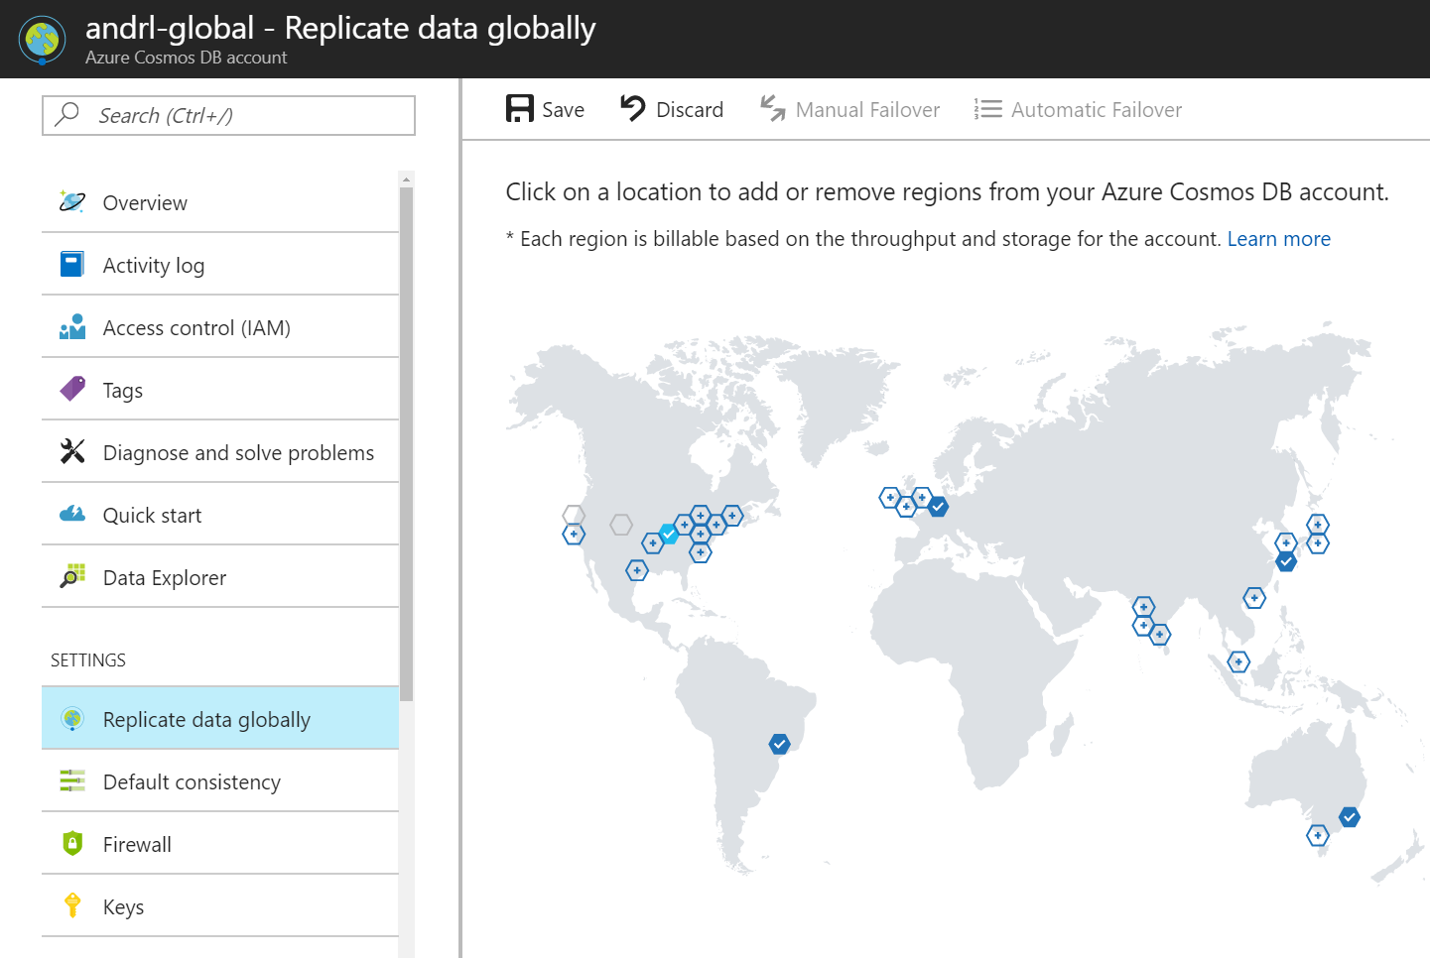
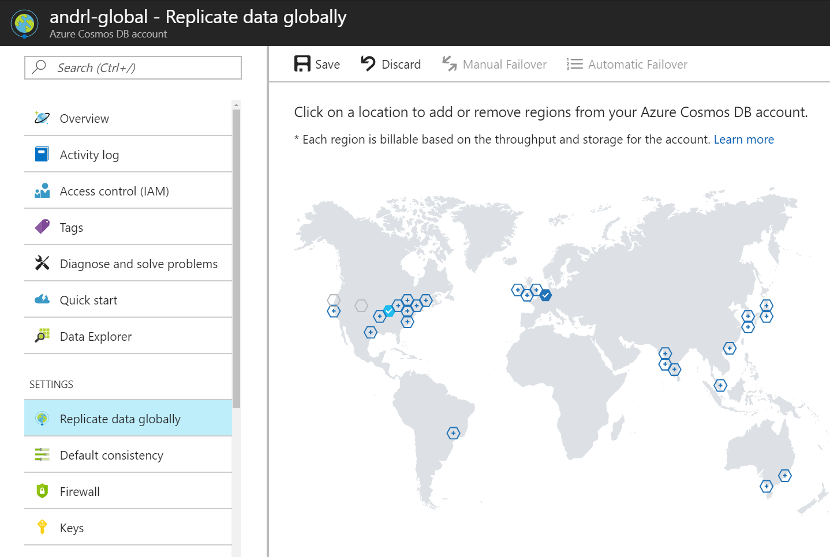

Replicating Data Globally

Slide 18
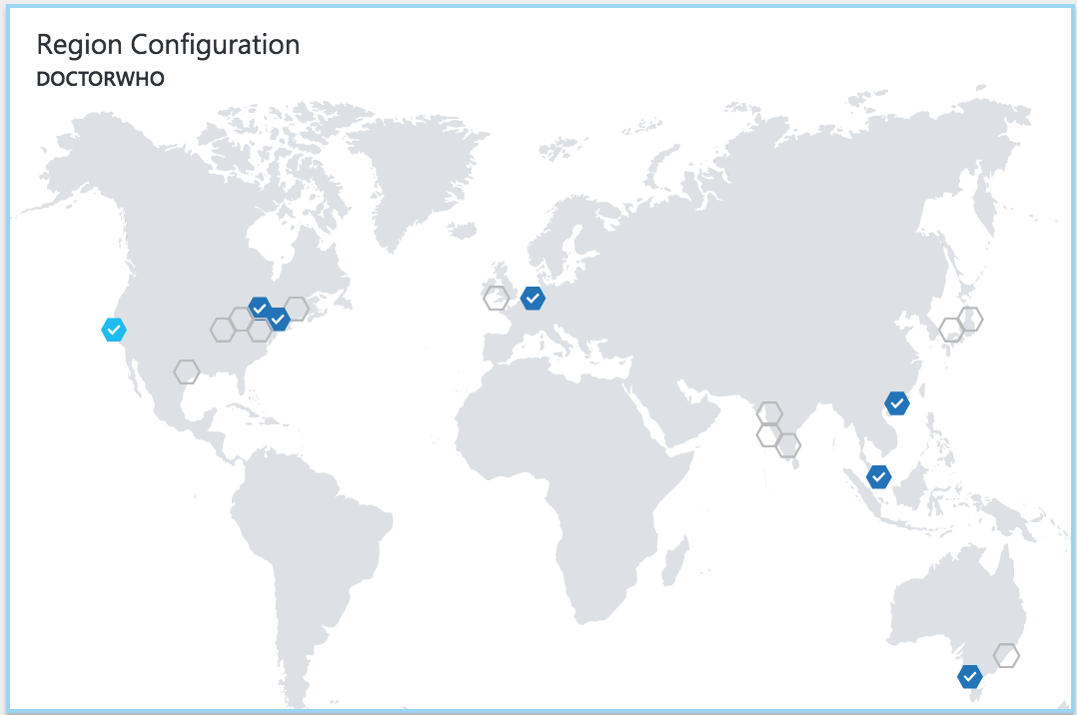
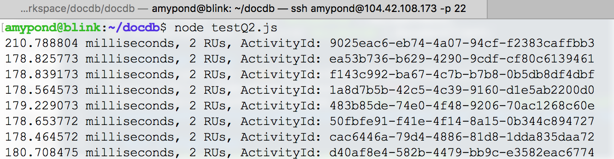
Replicating Data Globally

Slide 19
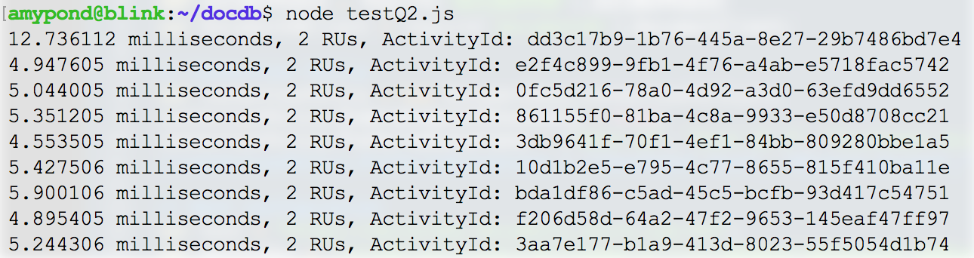
Replicating Data Globally

Slide 20
FIVE WELL-DEFINED CONSISTENCY MODELS
CHOOSE THE BEST CONSISTENCY MODEL FOR YOUR APP
Offers five consistency models
Provides control over performance-consistency tradeoffs, backed by comprehensive SLAs.
An intuitive programming model offering low latency and high availability for your planet-scale app.
Strong
Bounded-stateless
Session
Consistent prefix
Eventual
Notes:
Tunable Consistency -> Single digit latency
Bounded Staleness - Consistent Prefix. Reads lag behind writes by k prefixes or t interval
Session - Consistent Prefix. Monotonic reads, monotonic writes, read-your-writes, write-follows-reads
Consistent Prefix - Updates returned are some prefix of all the updates, with no gaps

Slide 21
ELASTIC SCALE OUT OF STORAGE AND THROUGHPUT
SCALES AS YOUR APPS’ NEEDS CHANGE
Independently and elastically scale storage and throughput across regions – even during unpredictable traffic bursts – with a database that adapts to your app’s needs.
Elastically scale throughput from 10 to 100s of millions of requests/sec across multiple regions
Support for requests/sec for different workloads
Pay only for the throughput and storage you need
Notes:
Elastic Scale out -> Tunable Consistency
Small storage – large throughput (e.g. notification broadcast/poll)
Large storage – small throughput (e.g. classic data/log store)

Slide 22
Resource Model
Leveraging Azure Cosmos DB to automatically scale your data across the globe
This module will reference partitioning in the context of all Azure Cosmos DB modules and APIs.
Account
Database
Database
Database
Database
Database
Container
Database
Database
Item
Notes:
A tenant of the Cosmos DB service starts by provisioning a database account. A database account manages one or more databases. A Cosmos DB database manages users, permissions and containers. A Cosmos DB resource container is a schema-agnostic container of arbitrary user-generated JSON items and JavaScript based stored procedures, triggers and user-defined-functions (UDFs). Entities under the tenant’s database account – databases, users, permissions, containers etc. are referred to as resources.
Each resource is uniquely identified by a stable and logical URI and represented as a JSON document. The overall resource model of an application using Cosmos DB is a hierarchical overlay of the resources rooted under the database account, and can be navigated using hyperlinks. Except for the item resource, which is used to represent arbitrary user defined JSON content, all other resources have a system-defined schema.
Container and item resources are further projected as reified resource types for a specific type of API interface. For example, while using document-oriented APIs, container and item resources are projected as collection (container) and document (item) resources, respectively; likewise, for graph-oriented API access, the underlying container and item resources are projected as graph (container), node (item) and edge (item) resources respectively; while accessing using a key-value API table (container) and item/row (item) are projected.

Slide 23
Account URI and Credentials
Account
********.azure.com
Database
Database
Database
IGeAvVUp …
Database
Database
Container
Database
Database
Item

Slide 24
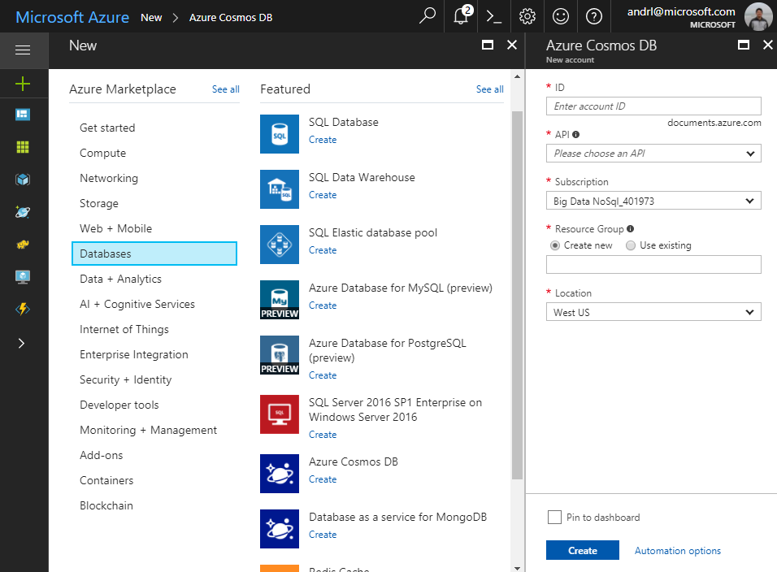
Creating Account
Account
Database
Database
Database
Database
Database
Container
Database
Database
Item

Slide 25
Database Representations
Account
Database
Database
Database
Database
Database
Database
Database
Container
Collection
Database
Database
Database
Database
Item
Document

Slide 26
Container Representations
Account
Database
Database
Database
Database
=
Database
Container
Collection
Graph
Table
Database
Database
Item

Slide 27
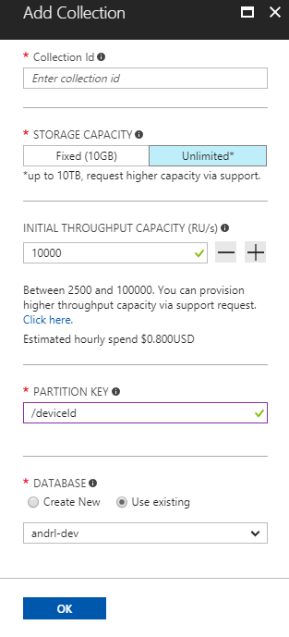
Creating Collections – SQL API
Account
Database
Database
Database
Database
Database
Container
Database
Database
Item

Slide 28
Container-Level Resources
Account
Database
Database
Database
Database
Database
Container
Database
Database
Sproc
Trigger
UDF
Conflict
Item

Slide 29
Resource Hierarchy
CONTAINERS
Logical resources “surfaced” to APIs as tables, collections or graphs, which are made up of one or more physical partitions or servers.
RESOURCE PARTITIONS
Consistent, highly available, and resource-governed coordination primitives
Consist of replica sets, with each replica hosting an instance of the database engine
Tenants
Follower
Tables
Collections
Graphs
Follower
Leader
Forwarder
To remote resource partition(s)
Containers
Replica Set
Resource Partitions

Slide 30
Partitioning
Leveraging Azure Cosmos DB to automatically scale your data across the globe
This module will reference partitioning in the context of all Azure Cosmos DB modules and APIs.

Slide 31
Partitions
Partition Key: User ID
Cosmos DB Container (e.g. Collection)
Logical Partitioning Abstraction
Behind the Scenes:
Physical Partition Sets
hash(User ID)
Psuedo-random distribution of data over range of possible hashed values

Slide 32
Partitions
hash(User ID)
Pseudo-random distribution of data over range of possible hashed values
Andrew
Mike
…
Bob
Dharma
Shireesh
Karthik
Rimma
Alice
Carol
…
…
Partition 1
Partition 2
Partition n
Frugal # of Partitions based on actual storage and throughput needs
(yielding scalability with low total cost of ownership)

Slide 33
Partitions
hash(User ID)
Pseudo-random distribution of data over range of possible hashed values
Andrew
Mike
…
Bob
Dharma
Shireesh
Karthik
Rimma
Alice
Carol
…
…
Partition 1
Partition 2
Partition n
What happens when partitions need to grow?

Slide 34
Partitions
hash(User ID)
Pseudo-random distribution of data over range of possible hashed values
Partition Ranges can be dynamically sub-divided to seamlessly grow database as the application grows while simultaneously maintaining high availability.
Partition management is fully managed by Azure Cosmos DB, so you don't have to write code or manage your partitions.
Dharma
Shireesh
Karthik
Rimma
Alice
Carol
…
Dharma
Shireesh
…
Rimma
Karthik
…
+
Partition x
Partition x1
Partition x2

Slide 35
Partition Design
IMPORTANT TO SELECT THE “RIGHT” PARTITION KEY
Partition keys acts as a means for efficiently routing queries and as a boundary for multi-record transactions.
KEY MOTIVATIONS
Distribute Requests
Distribute Storage
Intelligently Route Queries for Efficiency

Slide 36

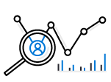



Partition Design
EXAMPLE SCENARIO
Contoso Connected Car is a vehicle telematics company. They are planning to store vehicle telemetry data from millions of vehicles every second in Azure Cosmos DB to power predictive maintenance, fleet management, and driver risk analysis.
The partition key we select will be the scope for multi-record transactions.
WHAT ARE A FEW POTENTIAL PARTITION KEY CHOICES?
Vehicle Model
Current Time
Device Id
Composite Key – Device ID + Current Time
Example – Contoso Connected Car
Notes:
Design Goals for Choosing a Good Partition Key
Distribute the overall request + storage volume
Avoid “hot” partition keys
Partition Key is scope for [efficient] queries and transactions
Queries can be intelligently routed via partition key
Omitting partition key on query requires fan-out
Steps for Success
Ballpark scale needs (size/throughput)
Understand the workload
# of reads/sec vs writes per sec
Use 80/20 rule to help optimize bulk of workload
For reads – understand top X queries (look for common filters)
For writes – understand transactional needs understand ratio of inserts vs updates
General Tips
Don’t be afraid of having too many partition keys
Partitions keys are logical
More partition keys => more scalability

Slide 37
Partition Key Choices
VEHICLE MODEL (e.g. Model A)
Most auto manufactures only have a couple dozen models. This will create a fixed number of logical partition key values; and is potentially the least granular option.
Depending how uniform sales are across various models – this introduces possibilities for hot partition keys on both storage and throughput.
CURRENT MONTH (e.g. 2018-04)
Auto manufacturers have transactions occurring throughout the year. This will create a more balanced distribution of storage across partition key values.
However, most business transactions occur on recent data creating the possibility of a hot partition key for the current month on throughput.
Storage Distribution
Throughput Distribution
Storage Distribution
Throughput Distribution
Rodel
Rodel
2018-03
2018-03
Prisma
Prisma
2018-04
2018-04
Turlic
Turlic
2018-05
2018-05
Coash
Coash
2018-06
2018-06
Example – Contoso Connected Car
Notes:
Date of flight
Use the example of a user searching for a flight. The user typically enters a date and the search is focused on that specific date
Search requests will target a predictable partition
Searching for a different date requires a new query
Searching across multiple dates (functionality not available with every airline) will create cross-partition queries

Slide 38
Partition Key Choices
DEVICE ID (e.g. Device123)
Each car would have a unique device ID. This creates a large number of partition key values and would have a significant amount of granularity.
Depending on how many transactions occur per vehicle, it is possible to a specific partition key that reaches the storage limit per partition key
COMPOSITE KEY (Device ID + Time)
This composite option increases the granularity of partition key values by combining the current month and a device ID. Specific partition key values have less of a risk of hitting storage limitations as they only relate to a single month of data for a specific vehicle.
Throughput in this example would be distributed more to logical partition key values for the current month.
Storage Distribution
Throughput Distribution
Storage Distribution
Throughput Distribution
C49E27EB
C49E27EB
C49E27EB-2018-05
C49E27EB-2018-05
FE53547A
FE53547A
C49E27EB-2018-06
C49E27EB-2018-06
E84906BE
E84906BE
4376B4BC-2018-05
4376B4BC-2018-05
4376B4BC
4376B4BC
4376B4BC-2018-06
4376B4BC-2018-06
Example – Contoso Connected Car
Notes:
Aircraft Type
Imbalance of aircraft types when comparing smaller vs. bigger routes

Slide 39
Partition Granularity
SELECT THE “RIGHT” LEVEL OF GRANULARITY FOR YOUR PARTITIONS
Partitions should be based on your most often occurring query and transactional needs. The goal is to maximize granularity and minimize cross-partition requests.
RODEL
RODEL_2017
RODEL_2017_LX
RODEL_2017_EX
RODEL_2018
RODEL_2018_LX
Don’t be afraid to have more partitions! More partition keys = More scalability
Example – Contoso Connected Car

Slide 40
Partition Granularity
SELECT THE “RIGHT” LEVEL OF GRANULARITY FOR YOUR PARTITIONS
Consider storage & throughput thresholds
Consider cross-partition query likelihood
RODEL
RODEL_2017
RODEL_2017_LX
RODEL_2017_EX
RODEL_2018
RODEL_2018_LX
Don’t be afraid to have more partitions! More partition keys = More scalability
Example – Contoso Connected Car

Slide 41
Partition Granularity
A CROSS-PARTITION QUERY IS NOT ALWAYS A BLIND FAN OUT QUERY
SELECT * FROM C
RODEL
RODEL_2017
RODEL_2017_LX
RODEL_2017_EX
RODEL_2018
RODEL_2018_LX
SELECT * FROM C WHERE partitionKey IN (A, B, C)
Example – Contoso Connected Car
Notes:
Cross-Partition query != Blind Fan Out
A query that has SELECT * FROM c WHERE partitionKey IN (A, B, C) can be run across the minimum number of partitions; where as a query that omits the partition key must blindly fan out.
Cross-partition queries aren’t inherently a bad thing. The reason why you’ll want to minimize fan-out is we don’t want to add the wasted effort for checking partitions that don’t have any relevant data

Slide 42
Partitions
Best Practices: Design Goals for Choosing a Good Partition Key
Distribute the overall request + storage volume
Avoid “hot” partition keys
Partition Key is scope for multi-record transactions and routing queries
Queries can be intelligently routed via partition key
Omitting partition key on query requires fan-out
Steps for Success
Ballpark scale needs (size/throughput)
Understand the workload
# of reads/sec vs writes per sec
Use pareto principal (80/20 rule) to help optimize bulk of workload
For reads – understand top 3-5 queries (look for common filters)
For writes – understand transactional needs
General Tips
Build a POC to strengthen your understanding of the workload and iterate (avoid analyses paralysis)
Don’t be afraid of having too many partition keys
Partitions keys are logical
More partition keys  more scalability

Slide 43
Handle any data with no schema or indexing required
Azure Cosmos DB’s schema-less service automatically indexes all your data, regardless of the data model, to delivery blazing fast queries.
Automatic index management
Synchronous auto-indexing
No schemas or secondary indices needed
Works across every data model
GEEK
Item | Color | Microwave safe | Liquid capacity | CPU | Memory | Storage
Geek mug | Graphite | Yes | 16ox | ??? | ??? | ???
Coffee Bean mug | Tan | No | 12oz | ??? | ??? | ???
Surface book | Gray | ??? | ??? | 3.4 GHz Intel Skylake Core i7-6600U | 16GB | 1 TB SSD
Notes:
Look at Andrew’s “variety” slide
Automatic and synchronous indexing of all ingested content - hash, range, geo-spatial, and columnar
No schemas or secondary indices ever needed
Resource governed, write optimized database engine with latch free and log structured techniques
Online and in-situ index transformations
While the database is fully schema-agnostic, schema-extraction is built in
Customers can get Avro schemas from the database

Slide 44
INDEXING JSON Documents
{
"locations": [
{
"country": "Germany",
"city": "Berlin"
},
{
"country": "France",
"city": "Paris"
}
],
"headquarter": "Belgium",
"exports": [
{ "city": "Moscow" },
{ "city": "Athens" }
]
}
locations
headquarter
exports
0
1
Belgium
0
1
country
city
country
city
city
city
Germany
Berlin
France
Paris
Moscow
Athens

Slide 45
INDEXING JSON Documents
{
"locations": [
{
"country": "Germany",
"city": "Bonn",
"revenue": 200
}
],
"headquarter": "Italy",
"exports": [
{
"city": "Berlin",
"dealers": [
{ "name": "Hans" }
]
},
{ "city": "Athens" }
]
}
locations
headquarter
exports
0
Italy
0
1
country
city
revenue
city
dealers
city
Germany
Bonn
200
Berlin
0
name
Hans

Slide 46
INDEXING JSON Documents
locations
headquarter
exports
locations
headquarter
exports
+
0
1
Belgium
0
1
0
Italy
0
1
country
city
country
city
city
city
country
city
revenue
city
dealers
city
Germany
Berlin
France
Paris
Moscow
Athens
Germany
Bonn
200
Berlin
0
Athens
name
Hans
Notes:
{
"locations": [
{
"country": "Germany",
"city": "Berlin"
},
{
"country": "France",
"city": "Paris"
}
],
"headquarter": "Belgium",
"exports": [
{ "city": "Moscow" },
{ "city": "Athens" }
]
}
{
"locations": [
{
"country": "Germany",
"city": "Bonn",
"revenue": 200
}
],
"headquarter": "Italy",
"exports": [
{
"city": "Berlin",
"dealers": [
{ "name": "Hans" }
]
},
{ "city": "Athens" }
]
}

Slide 47
Inverted Index
{1, 2}
{1, 2}
locations
{1, 2}
headquarter
{1, 2}
exports
{1, 2}
0
{1}
1
{1}
Belgium
{2}
Italy
{1, 2}
0
{1, 2}
1
{1, 2}
country
{1, 2}
city
{1, 2}
revenue
{1, 2}
country
{1, 2}
city
{1, 2}
city
{2}
dealers
{1, 2}
city
{1}
Berlin
{1}
France
{1}
Paris
{1}
Moscow
{1, 2}
Germany
{2}
Bonn
{2}
200
{2}
Berlin
{2}
0
{2}
Athens
{2}
name
{2}
Hans

Slide 48
Index POLICIES
CUSTOM INDEXING POLICIES
Though all Azure Cosmos DB data is indexed by default, you can specify a custom indexing policy for your collections. Custom indexing policies allow you to design and customize the shape of your index while maintaining schema flexibility.
Define trade-offs between storage, write and query performance, and query consistency
Include or exclude documents and paths to and from the index
Configure various index types
{
"automatic": true,
"indexingMode": "Consistent",
"includedPaths": [{
"path": "/*",
"indexes": [{
"kind": "Hash",
"dataType": "String",
"precision": -1
}, {
"kind": "Range",
"dataType": "Number",
"precision": -1
}, {
"kind": "Spatial",
"dataType": "Point"
}]
}],
"excludedPaths": [{
"path": "/nonIndexedContent/*"
}]
}
Notes:
Include or exclude documents and paths to and from the index
You can exclude or include specific documents in the index when you insert or replace the documents in the collection. You can also include or exclude specific JSON properties, also called paths, to be indexed across documents that are included in an index. Paths include wildcard patterns.
Configure various index types
For each included path, you can specify the type of index the path requires for a collection. You can specify the type of index based on the path's data, the expected query workload, and numeric/string “precision.”
Configure index update modes
Azure Cosmos DB supports three indexing modes: Consistent, Lazy, and None. You can configure the indexing modes via the indexing policy on an Azure Cosmos DB collection.

Slide 49
Online Index Transformations
ON-THE-FLY INDEX CHANGES
In Azure Cosmos DB, you can make changes to the indexing policy of a collection on the fly. Changes can affect the shape of the index, including paths, precision values, and its consistency model.
A change in indexing policy effectively requires a transformation of the old index into a new index.
v1 Policy
v2 Policy
New document writes (CRUD) & queries
t₀
t₁
PUT /colls/examplecollection { indexingPolicy: … }
GET /colls/examplecollection x-ms-index-transformation-progress: 100
Notes:
Index transformations are made online. This means that the documents indexed per the old policy are efficiently transformed per the new policy without affecting the write availability or the provisioned throughput of the collection. The consistency of read and write operations made by using the REST API, SDKs, or from within stored procedures and triggers is not affected during index transformation. There's no performance degradation or downtime to your apps when you make an indexing policy change.

Slide 50
Index Tuning
METRICS ANALYSIS
The SQL APIs provide information about performance metrics, such as the index storage used and the throughput cost (request units) for every operation. You can use this information to compare various indexing policies, and for performance tuning.
When running a HEAD or GET request against a collection resource, the x-ms-request-quota and the x-ms-request-usage headers provide the storage quota and usage of the collection.
You can use this information to compare various indexing policies, and for performance tuning.
Update Index Policy
View Headers
Query Collection
Index
Collection
Notes:
Update index policy
Query collection
View Results
Repeat Step 1

Slide 51
Request Units
Request Units (RUs) is a rate-based currency
Abstracts physical resources for performing requests
Key to multi-tenancy, SLAs, and COGS efficiency
Foreground and background activities
% Memory
% CPU
% IOPS

Slide 52
Request Units
Normalized across various access methods
1 RU = 1 read of 1 KB document
Each request consumes fixed RUs
Applies to reads, writes, query, and stored procedures
GET
=
POST
=
PUT
=
Query
=
…

Slide 53
Request Units
Provisioned in terms of RU/sec
Rate limiting based on amount of throughput provisioned
Can be increased or decreased instantaneously
Metered Hourly
Background processes like TTL expiration, index transformations scheduled when quiescent
Rate limit
Max RU/sec
Incoming Requests
No rate limiting
Min RU/sec
Replica Quiescent
Notes:
We want to avoid throttling (rate limiting)

Slide 54
Measuring RU CHARGE
ANALYZE QUERY COMPLEXITY
The complexity of a query impacts how many Request Units are consumed for an operation. The number of predicates, nature of the predicates, number of system functions, and the number of index matches / query results all influence the cost of query operations.
MEASURE QUERY COST
To measure the cost of any operation (create, update, or delete):
Inspect the x-ms-request-charge header
Inspect the RequestCharge property in ResourceResponse or FeedResponse in the SDK
NUMBER OF INDEXED TERMS IMPACTS WRITE RU CHARGES
Every write operation will require the indexer to run. The more indexed terms you have, the more indexing will be directly having an effect on the RU charge.
You can optimize for this by fine-tuning your index policy to include only fields and/or paths certain to be used in queries.

Slide 55
Measuring RU CHARGE
STABILIZED LOGICAL CHARGES
Azure Cosmos DB uses information about past runs to produce a stable logical charge for the majority of CRUD or query operations.
Since this stable charge exists, we can rely on our operations having a high degree of predictability with very little variation. We can use the predictable RU charges for future capacity planning.
BULK OF QUERY RU CHARGES IS IO
Query RU is directly proportional to the quantity of query results.
Notes:
Azure Cosmos DB uses ML to produce a stable logical charge for vast majority of operations (CRUD and query). This gives a high degree of predictability for capacity planning (if creating document X costs 5 RU’s today, we can rely on the fact that it will cost 5 RU’s tomorrow). This isolates RU charge from variability in physical resource utilization due to other noisy processes like garbage collection

Slide 56
RU Charge Measurement Example
ResourceResponse<Document> response = await client.CreateDocumentAsync(
collectionLink,
document
);
var requestUnits = response.RequestCharge;

Slide 57

RU Charge Measurement Example
client.createDocument(
collectionLink,
documentDefinition,
function (err, document, headers) {
if (err) {
console.log(err);
}
var requestData = headers['x-ms-request-charge'];
}
);

Slide 58

RU Charge Measurement Example
ResourceResponse<Document> response = client.createDocument(
collectionLink,
documentDefinition,
null,
false
);
Double requestCharge = response.getRequestCharge();

Slide 59
Request Unit Pricing Example
Storage Cost
Avg Record Size (KB) | 1
Number of Records | 100,000
Total Storage (GB) | 100
Monthly Cost per GB | $0.25
Expected Monthly Cost for Storage | $25.00
Throughput Cost
Operation Type | Number of Requests per Second | Avg RU's per Request | RU's Needed
Create | 100 | 5 | 500
Read | 400 | 1 | 400
Total RU/sec | 900
Monthly Cost per 100 RU/sec | $6.00
Expected Monthly Cost for Throughput | $54.00
Total Monthly Cost
[Total Monthly Cost] = [Monthly Cost for Storage] + [Monthly Cost for Throughput]
= $25 + $54
= $79 per month
* pricing may vary by region; for up-to-date pricing, see: https://azure.microsoft.com/pricing/details/cosmos-db/

Slide 60
Multiple data models and apis
USE THE MODEL THAT FITS YOUR REQUIREMENTS, AND THE APIS, TOOLS, AND FRAMEWORKS YOU PREFER
Cosmos DB offers a multitude of APIs to access and query data including, SQL, various popular OSS APIs, and native support for NoSQL workloads.
Use key-value, tabular, graph, and document data
Data is automatically indexed, with no schema or secondary indexes required
Blazing fast queries with no lag
SQL
MongoDB
Table API
Column-family
Document
Key-value
Graph
Notes:
Multi – Model -> Elastic Scale out
No need to convert you data to meet any particular model

Slide 61
COMPREHENSIVE SLAs
RUN YOUR APP ON WORLD-CLASS INFRASTRUCTURE
Azure Cosmos DB is the only service with financially-backed SLAs for millisecond latency at the 99th percentile, 99.999% HA and guaranteed throughput and consistency
Latency
HA
Throughput
Consistency
<10 ms
99.999%
Guaranteed
Guaranteed
99th percentile
Notes:
HA 99.999% for multi-region read; 99.99% for single region deployments

Slide 62
Trust your data to industry-leading Security & Compliance
Azure is the world’s most trusted cloud, with more certifications than any other cloud provider.
Enterprise grade security
Encryption at Rest
Encryption is enabled automatically by default
Comprehensive Azure compliance certification
Notes:
Encryption at Rest
Always encrypted at rest and in motion
Data, index, backups, and attachments encrypted
Encryption is enabled automatically by default
No impact on performance, throughput or availability
Transparent to your application
Comprehensive Azure compliance certification
ISO 27001, ISO 27018, EUMC, HIPAA, PCI
SOC1 and SOC2 (Audit complete, Certification in Q2 2017)
FedRAMP, IRS 1075, UK Official (IL2) (Q2 2017)
HITRUST (H2 2017)

